Slide 1

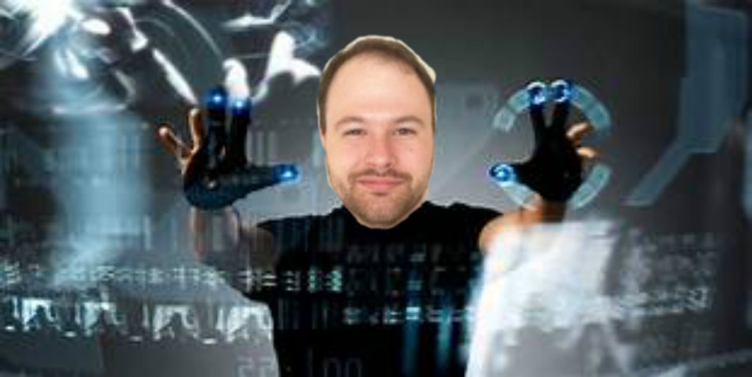
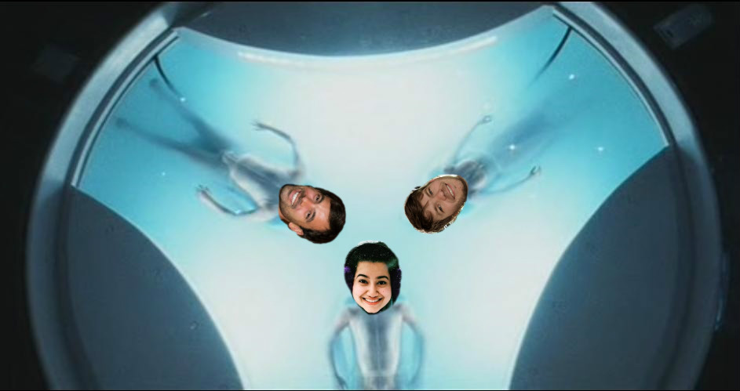
Starring:
Dr.Coop – John Anderton
Anika Rahman – Agatha
Andy Watson – Arthur
David Shaffer – Dasher
Geoff Weathersby – Politician 1
Yassin Alsahlani – Politician 2

Slide 2
Mission:
Model and Predict Crime Demographics to save Dr.Coop’s life
Data Source:
Bureau of Justice Statistics API
https://www.bjs.gov/developer/index.cfm
Data collected by US Census Bureau
Surveys of victimized people and households in non-fatal incidents
Models and Tools Used:
Sci-Kit Learn
Keras
Random Forest
Pandas
MongoDB
Tableau

Slide 3
Data Points:
Personal Victimizations (~50,000 records spanning 1995-2017)
Age
Household Income
Injury
Location of Incident
Location of Residence
Marital Status
Population Size
Race
Region
Reported to the Police (Y or N)
Sex
Type of Crime
Victim Offender-Relationship
Weapon Category
Year
Data Source:
Bureau of Justice Statistics API
https://www.bjs.gov/developer/index.cfm
Data collected by US Census Bureau
Surveys of victimized people and households in non-fatal incidents
Models and Tools Used:
Sci-Kit Learn
Keras
Pandas
MongoDB
Tableau

Slide 4
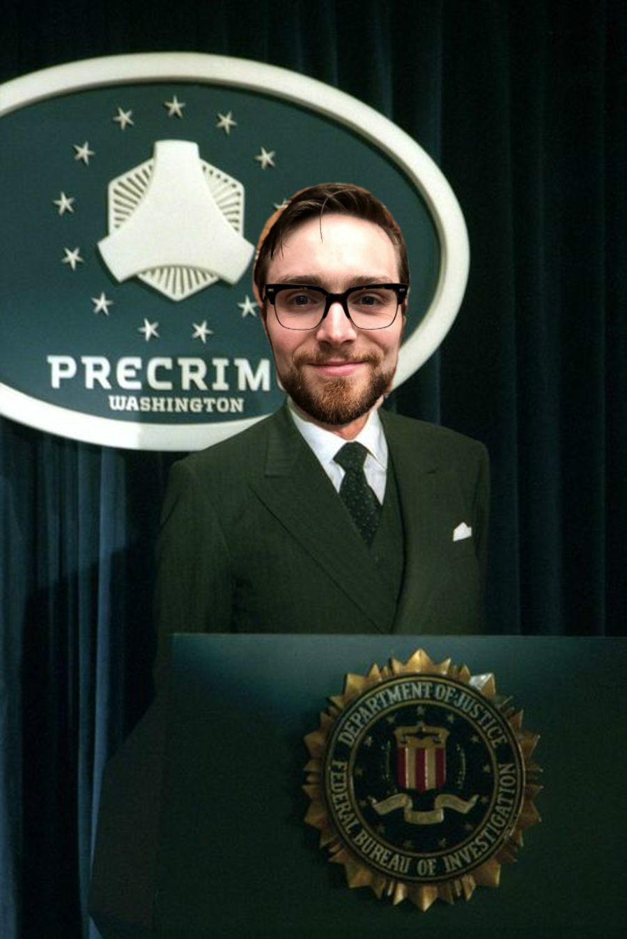
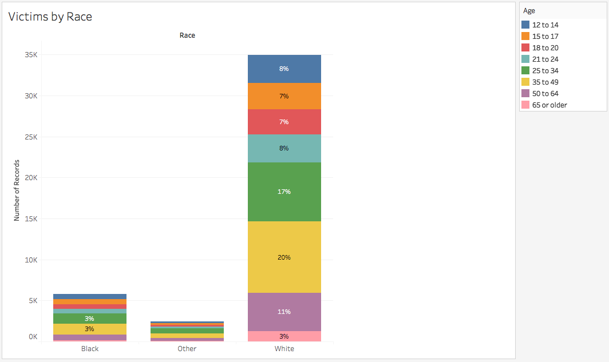
It appears we have a potential bias in our data from the Bureau of Justice

Slide 5
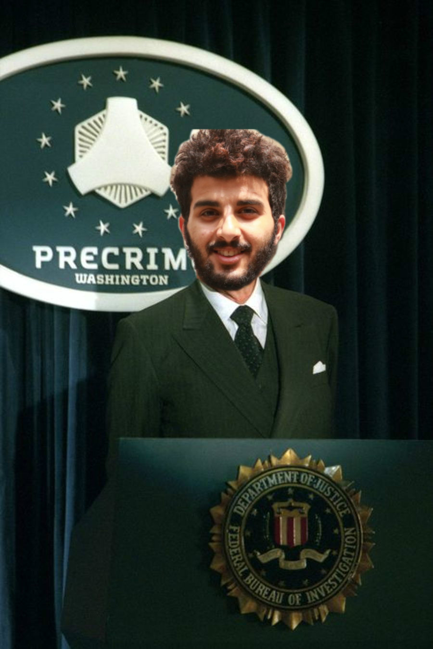
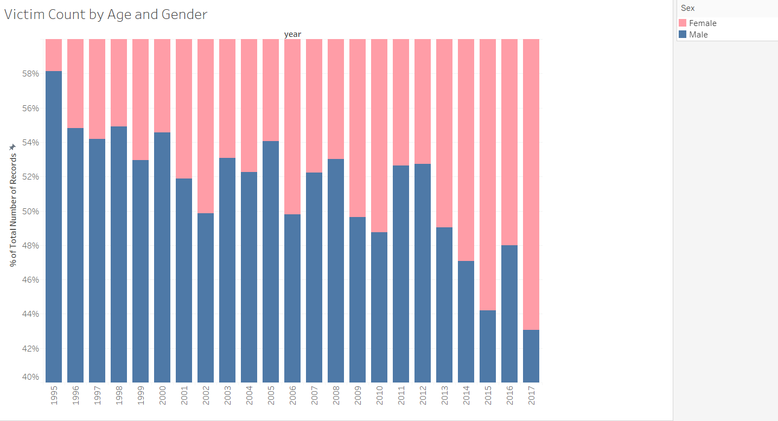
We may have experienced in cultural shift in crime reporting

Slide 6
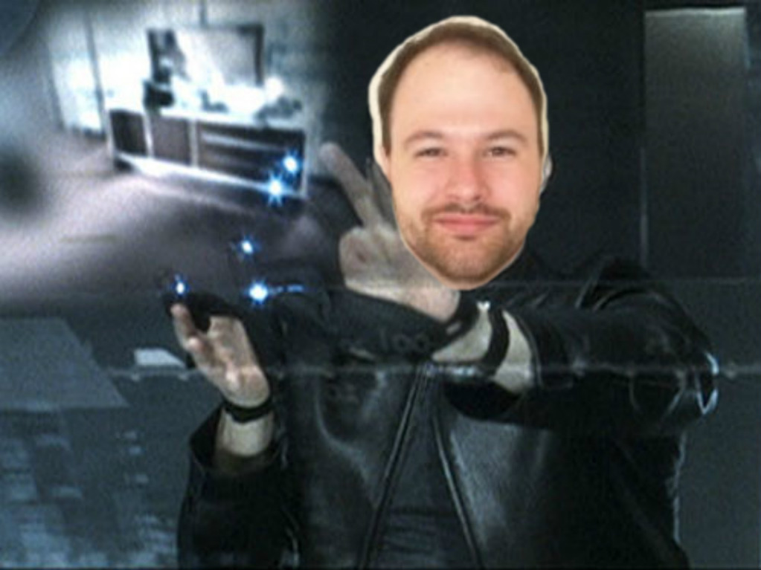
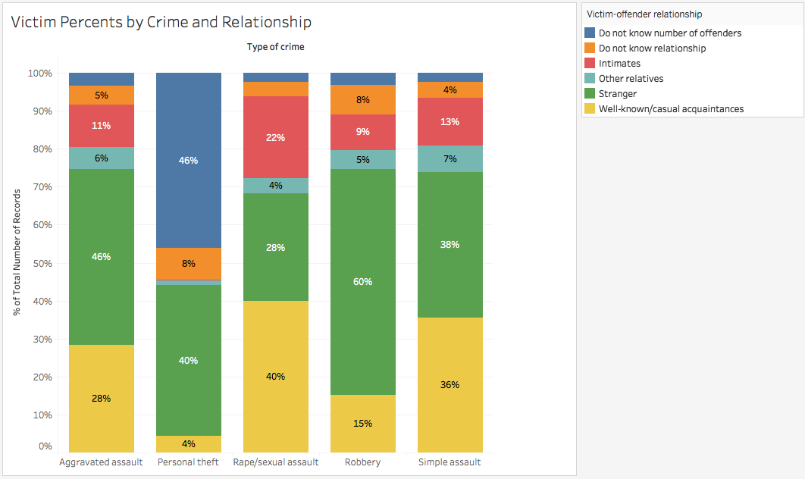
Victims know their offenders in some way in the majority of Assault crime… w/Sexual Assault having the largest majority at 66%

Slide 7

After running the Random Forest model and calculating feature importance, I’ve determined that…

Slide 8
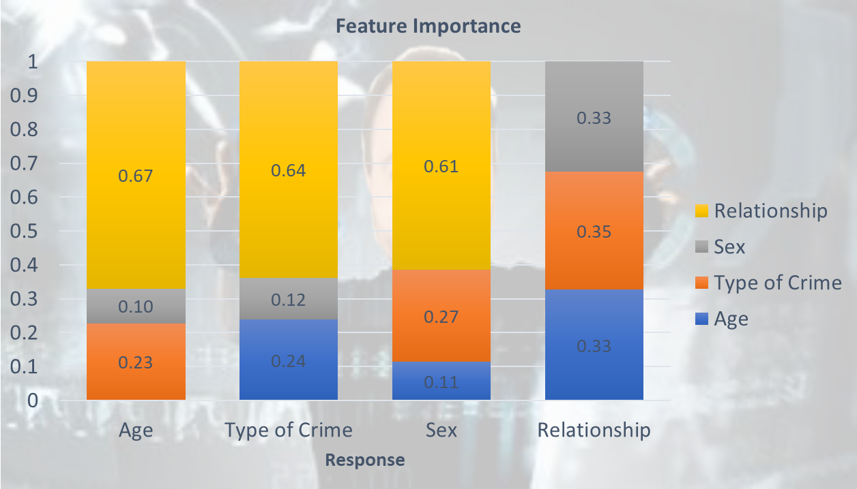

Slide 9
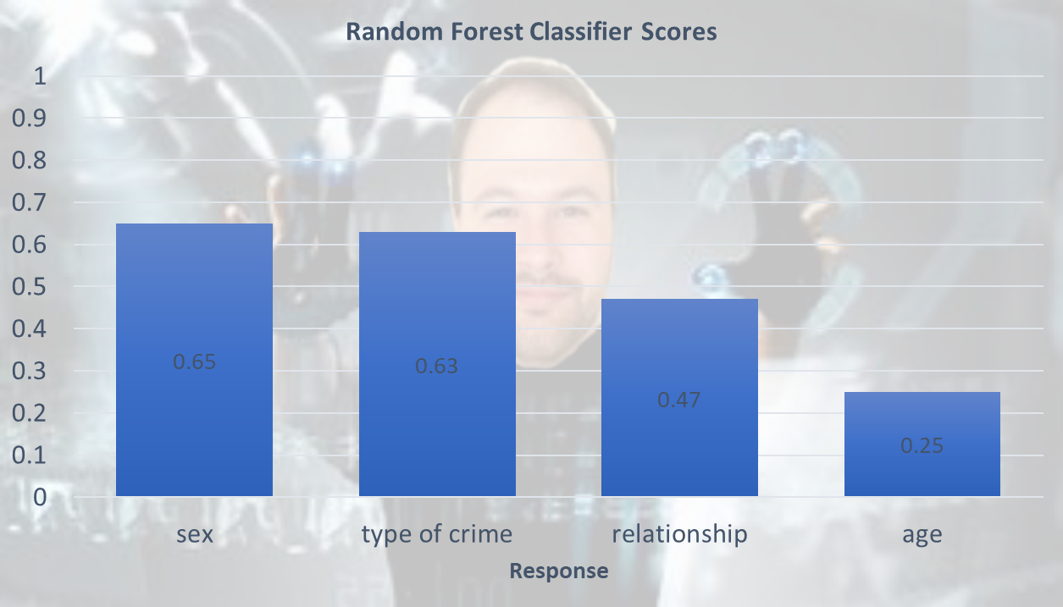

Slide 10

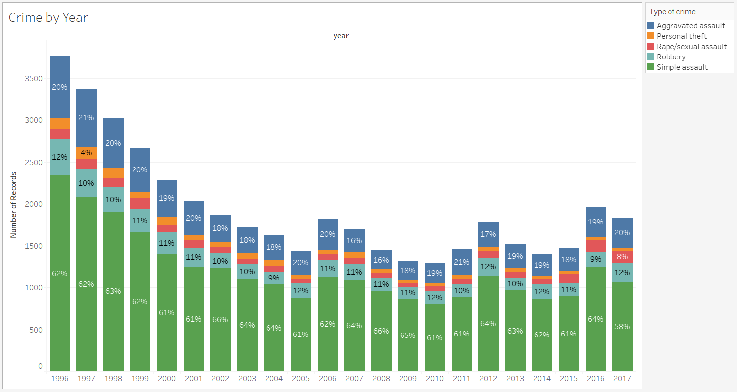
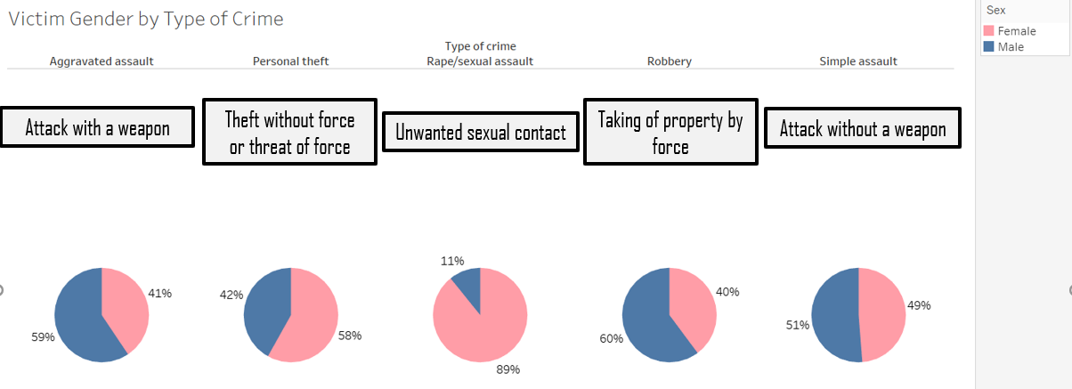
Crime appears to have decreased significantly between the late 90’s and now…yet hear I am being accused of committing a crime

Slide 11
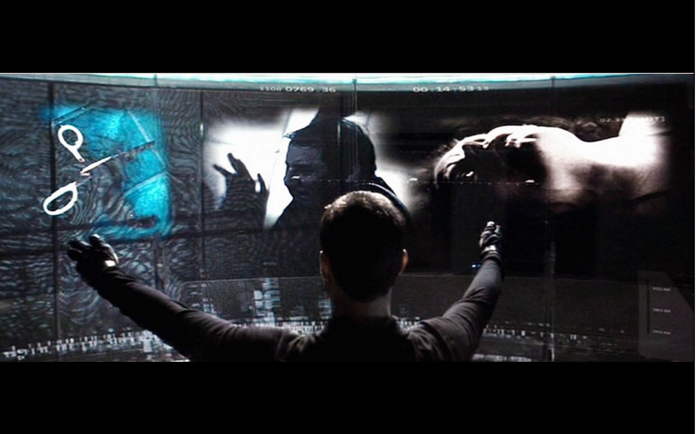
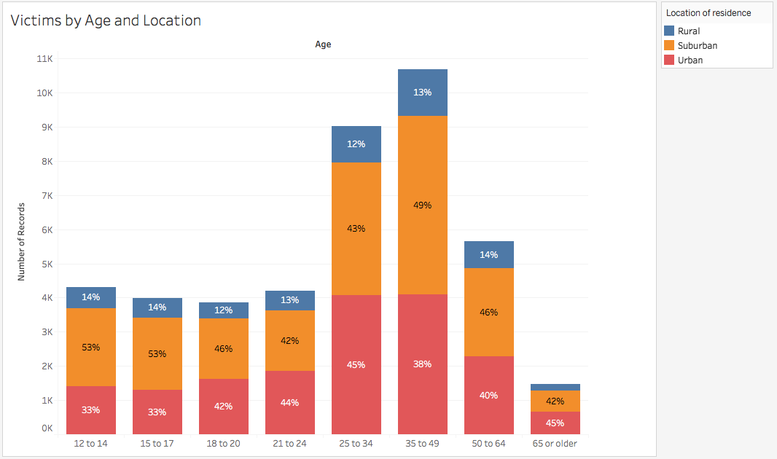
Victims of ages 25-49 are ~46% of the victimized population

Slide 12
Conclusions and Next Steps:
Run the model using the entire dataset
Apply ML and Classification to a crime dataset with perpetrator demographics
Relationship of victim is most critical in determining crime characteristics
Limitations:
-Potential racial bias
-NCVS redesigned sampling methods in 2006
-Each record is self-reported
-Each record is a victimization not a victim
I’m just excited to have a normal life again

